Slide 1
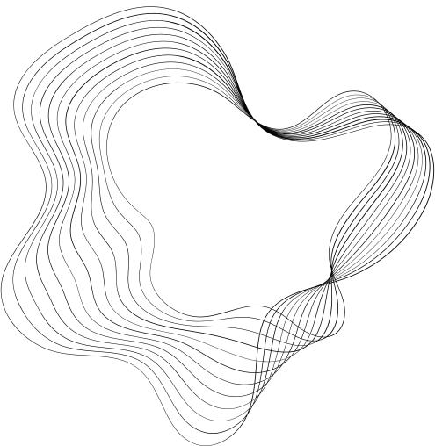

SOCIAL
PIGGYBACK
PATEL ARYAN & PANCHAL MIHIR

Slide 2




USE CASE
AND
USERS
THIS END PRODUCT WHEN PUBLISHED CAN BE
USED BY THE END - USER TO SEARCH FOR SOCIAL MEDIA CONTENT SEARCHING EASILY AND AT THEIR FINGERTIPS
THIS IS NOT BASED ON KEYWORD BUT ON SEMANTIC SEARCHING TECHNIQUES SO THE TRADITIONAL SEARCHING TECHNIQUES ARE OUTRIDDEN BY THESE ALGORITHMS.

Slide 3

BENEFITS
80%
WHEN USING SEMANTIC SEARCHING TECHNIQUES YOU GET THE BEST RESULTS
UNLIKE WHAT IS DONE IN TRADITIONAL SEARCHES BECAUSE SEMANTICS DO NOT BIASE KEYWORDS
80% OF THE CONTENT SEARCHED USING KEYWORDS IS NOT EXACTLY WHAT IS ASKED FOR

Slide 4




WHY WE NEED IT
WHY BETTER?
THERE ARE OTHER PROGRAMS WHICH GET YOU BETTER RESULTS THAN TRADITIONAL SEARCHES BUT IT HAS LLM BASED TECH WHICH TAKES UP A LOT OF DATA
LLM HAS TB'S OF DATA WHICH IS NEEDED TO GET OVER FOR EFFICIENT EXECUTION
SO USING THIS ONE CAN USE FRONTEND OR SIMPLE UI ON HIS/HER MOBILE DEVICES FOR EASE OF ACCESS

